Slide 1
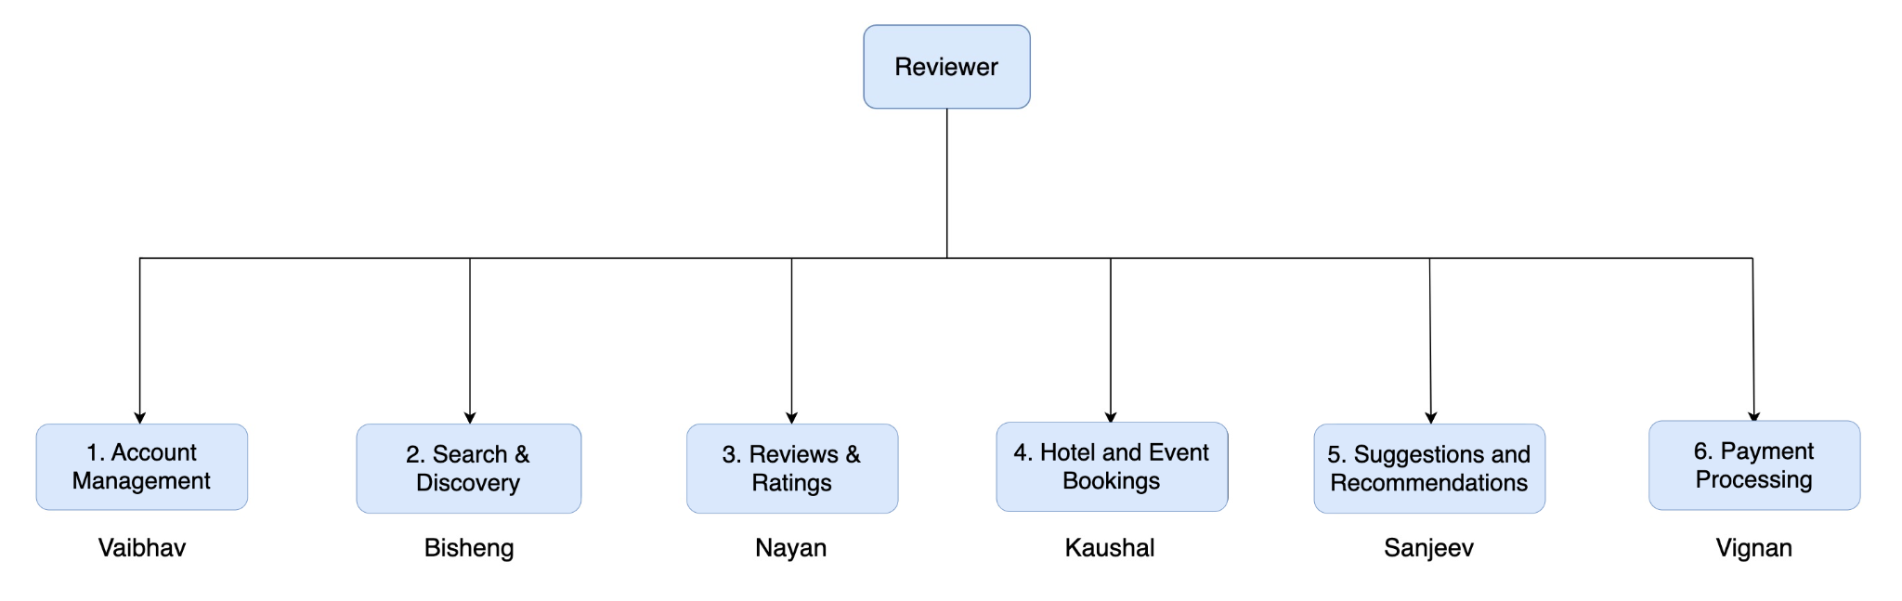
Reviewer: Functional Decomposition Diagram

Slide 2
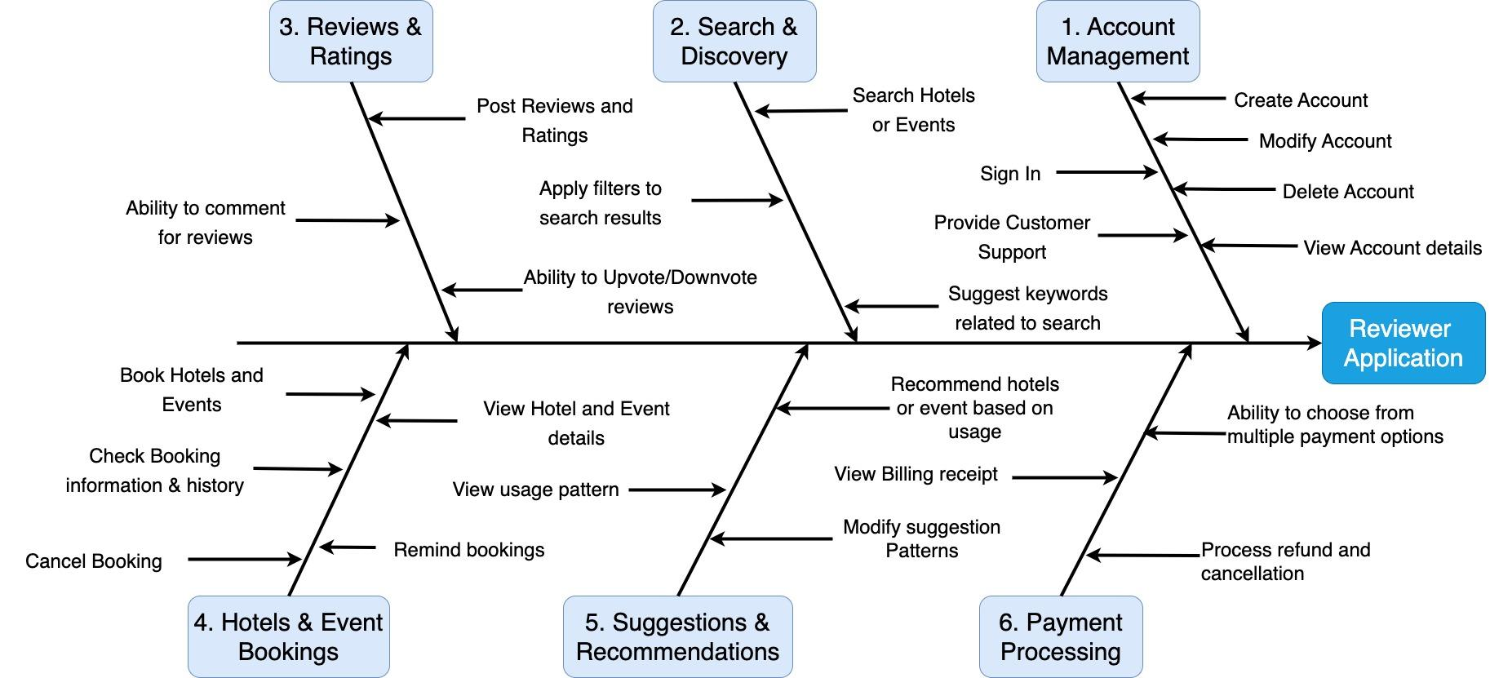
Reviewer: Fish-bone Diagram

